Slide 1
Introduction
Chapter 1

Slide 2
The Nature of Derivatives
A derivative is an instrument whose value depends on the values of other more basic underlying variables
Derivatives play a key role in transferring risks in the economy
Notes:
2

Slide 3
Examples of Derivatives
Futures Contracts
Forward Contracts
Swaps
Options
Notes:
3

Slide 4
Ways Derivatives are Used
To hedge risks
To speculate (take a view on the future direction of the market)
To lock in an arbitrage profit
To change the nature of a liability
To change the nature of an investment without incurring the costs of selling one portfolio and buying another
Notes:
4

Slide 5
Futures Contracts
A futures contract is an agreement to buy or sell an asset at a certain time in the future for a certain price
By contrast in a spot contract there is an agreement to buy or sell the asset immediately (or within a very short period of time)
Notes:
7

Slide 6
Exchanges Trading Futures
CME Group
Intercontinental Exchange
Euronext
Eurex
BM&FBovespa (Sao Paulo, Brazil)
National Stock Exchange of India
China Financial futures Exchange
and many more (see list at end of book)

Slide 7
Futures Price
The futures prices for a particular contract is the price at which you agree to buy or sell at a future time
It is determined by supply and demand in the same way as a spot price
Notes:
8

Slide 8
Electronic Trading
Traditionally futures contracts have been traded using the open outcry system where traders physically meet on the floor of the exchange
This has now been largely replaced by electronic trading and high frequency (algorithmic) trading has become an increasingly important part of the market

Slide 9
Examples of Futures Contracts
Agreement to:
  buy 100 oz. of gold @ US$1100/oz. in December
  sell £62,500 @ 1.5500 US$/£ in March
  sell 1,000 bbl. of oil @ US$40/bbl. in April
Notes:
9

Slide 10
Terminology
The party that has agreed to buy has a long position
The party that has agreed to sell has a short position
Notes:
10

Slide 11
Example
January: an investor enters into a long futures contract to buy 100 oz of gold @ $1,100 per oz in April
April: the price of gold is $1,175 per oz
  What is the investor’s profit or loss?
Notes:
11

Slide 12
Over-the Counter Markets
The over-the counter market is an important alternative to exchanges
Trades are usually between financial institutions, corporate treasurers, and fund managers
Transactions are much larger than in the exchange-traded market

Slide 13
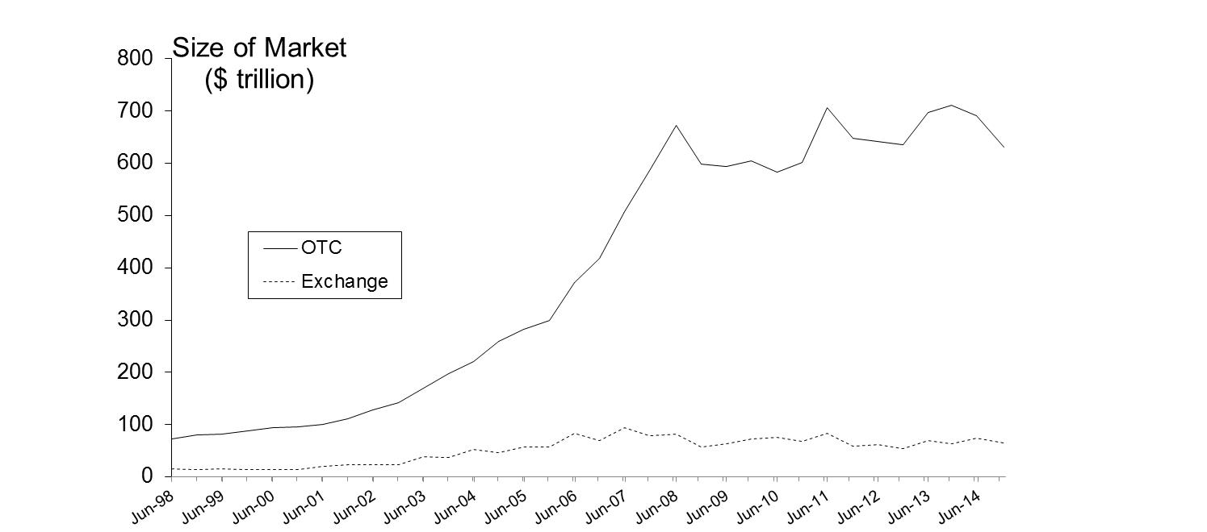
Size of OTC and Exchange-Traded Markets
(Figure 1.2, Page 6)
Source: Bank for International Settlements. Chart shows total principal amounts for OTC market and value of underlying assets for exchange market

Slide 14
The Lehman Bankruptcy (Business Snapshot 1.1, page 5)
Lehman’s filed for bankruptcy on September 15, 2008. This was the biggest bankruptcy in US history
Lehman was an active participant in the OTC derivatives markets and got into financial difficulties because it took high risks and found it was unable to roll over its short term funding
It had hundreds of thousands of OTC derivatives transactions outstanding with about 8,000 counterparties
Unwinding these transactions has been challenging for both the Lehman liquidators and their counterparties

Slide 15
New Regulations for OTC Market
The OTC market is becoming more like the exchange-traded market. New regulations introduced since the crisis mean that
  Standard OTC products traded between financial institutions must be traded on swap execution facilities
  A central clearing party must be used as an intermediary for standard products when they are traded between financial institutions
  Trades must be reported to a central registry

Slide 16
Systemic Risk
New regulations were introduced because of concerns about systemic risk
OTC transactions between financial institutions lead to systemic risk because a default by one large financial institution can lead to losses by other financial institutions…

Slide 17
Forward Contracts
Forward contracts are similar to futures except that they trade in the over-the-counter market
Forward contracts are popular on currencies and interest rates

Slide 18
Forward Price
The forward price for a contract is the delivery price that would be applicable to the contract if were negotiated today (i.e., it is the delivery price that would make the contract worth exactly zero)
The forward price may be different for contracts of different maturities
Notes:
11

Slide 19
Foreign Exchange Quotes for USD/GBP exchange rate on May 13, 2015 (See Table 1.1, page 7)
 | Bid | Offer
Spot | 1.5746 | 1.5750
1-month forward | 1.5742 | 1.5747
3-month forward | 1.5736 | 1.5742
6-month forward | 1.5730 | 1.5736

Slide 20
Example
On May 13, 2015 the treasurer of a corporation might enter into a long forward contract to sell £100 million in six months at an exchange rate of 1.5736
This obligates the corporation to pay £1 million and receive $157.36 million on December 13, 2015
What are the possible outcomes?

Slide 21
Options
A call option is an option to buy a certain asset by a certain date for a certain price (the strike price)
A put option is an option to sell a certain asset by a certain date for a certain price (the strike price)

Slide 22
American vs European Options
An American option can be exercised at any time during its life
A European option can be exercised only at maturity

Slide 23
Google Call Option Prices (May 13, 2015 Stock Price: bid 532.20, offer 532.34; See page 8)
Strike Price ($) | June Bid | June Offer | Sept Bid | Sept Offer | Dec Bid | Dec Offer
475 | 57.90 | 61.80 | 66.00 | 68.90 | 73.50 | 76.50
500 | 34.80 | 37.10 | 45.90 | 47.90 | 54.90 | 56.60
525 | 16.70 | 17.30 | 30.40 | 31.30 | 40.20 | 41.10
550 | 5.60 | 6.20 | 18.60 | 19.40 | 28.10 | 29.00
575 | 1.55 | 1.80 | 10.50 | 11.30 | 18.80 | 20.20

Slide 24
Google Put Option Prices (June 25, 2015 Stock Price: bid 532.20, offer 532.34; See page 8)
Strike Price ($) | June Bid | June Offer | Sept Bid | Sept Offer | Dec Bid | Dec Offer
475 | 0.95 | 1.05 | 5.50 | 9.20 | 12.50 | 15.20
500 | 2.95 | 3.30 | 13.00 | 13.80 | 21.30 | 22.10
525 | 9.40 | 9.90 | 22.40 | 23.20 | 31.30 | 32.00
550 | 22.90 | 24.40 | 35.20 | 36.40 | 44.10 | 45.00
575 | 42.70 | 45.80 | 51.90 | 53.50 | 59.70 | 61.00

Slide 25
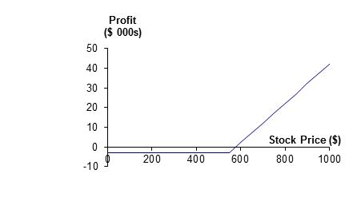
Net profit from purchasing a contract consisting of 100 December call options with a strike price of $550 for $29 per option

Slide 26
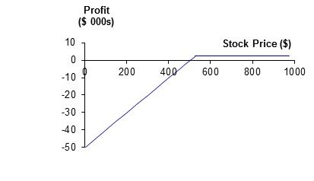
Net profit from selling a contract consisting of 100 September put options with a strike price of $525 for $22.40 per option

Slide 27
Exchanges Trading Options
Chicago Board Options Exchange
International Securities Exchange
NYSE Euronext
Eurex (Europe)
and many more (see list at end of book)

Slide 28
Options vs Futures/Forwards
A futures/forward contract gives the holder the obligation to buy or sell at a certain price
An option gives the holder the right to buy or sell at a certain price

Slide 29
Hedge Funds (see Business Snapshot 1.3, page 12)
Hedge funds are not subject to the same rules as mutual funds and cannot offer their securities publicly.
Mutual funds must
  disclose investment policies,
  make shares in the fund redeemable at any time,
  limit use of leverage
Hedge funds are not subject to these constraints.
Typical hedge fund fee: 2 plus 20%

Slide 30
Three Reasons for Trading Derivatives:
Hedging, Speculation, and Arbitrage
Hedge funds trade derivatives for all three reasons
When a trader has a mandate to use derivatives for hedging or arbitrage, but then switches to speculation, large losses can result. (See SocGen, Business Snapshot 1.4, page 19)

Slide 31
Hedging Examples
A US company will pay £10 million for imports from Britain in 3 months and decides to hedge using a long position in a forward contract
An investor owns 1,000 shares currently worth $28 per share. A two-month put with a strike price of $27.50 costs $1. The investor decides to hedge by buying 10 contracts ….
Notes:
16

Slide 32
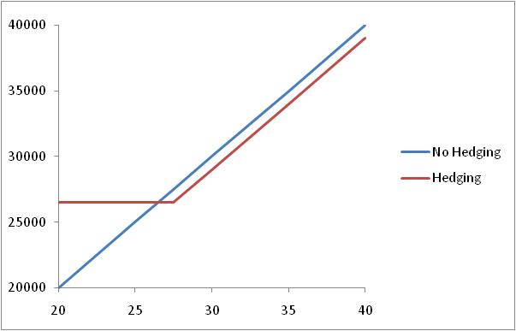
Value of Shares with and without Hedging (Fig 1.4, page 14)

Slide 33
Speculation Example
An investor with $2,000 to invest feels that a stock price will increase over the next 2 months. The current stock price is $20 and the price of a 2-month call option with a strike of $22.50 is $1
What are the alternative strategies?
Notes:
17

Slide 34
Arbitrage Example (page 17)
A stock price is quoted as £100 in London and $152 in New York
The current exchange rate is 1.5500
What is the arbitrage opportunity?

Slide 35
1. Gold: An Arbitrage Opportunity?
Suppose that:
  The spot price of gold is US$1,100 per ounce
  The quoted 1-year futures price of gold is US$1,200
  The 1-year US$ interest rate is 2% per annum
  No income or storage costs for gold
Is there an arbitrage opportunity?
Notes:
18

Slide 36
2. Gold: Another Arbitrage Opportunity?
Suppose that:
  The spot price of gold is US$1,100
  The quoted 1-year futures price of gold is US$1,050
  The 1-year US$ interest rate is 2% per annum
  No income or storage costs for gold
Is there an arbitrage opportunity?
Notes:
19

Slide 37
The Futures Price of Gold
If the spot price of gold is S & the futures price is for a contract deliverable in T years is F, then
F = S (1+r )^{T}
where r is the 1-year (domestic currency) risk-free rate of interest.
In our examples, S=1100, T=1, and r=0.02 so that
F = 1100(1+0.02) = 1122
Notes:
20

Slide 38
1. Oil: An Arbitrage Opportunity?
Suppose that:
  The spot price of oil is US$40
  The quoted 1-year futures price of oil is US$50
  The 1-year US$ interest rate is 2% per annum
  The storage costs of oil are 1% per annum
Is there an arbitrage opportunity?
Notes:
21

Slide 39
2. Oil: Another Arbitrage Opportunity?
Suppose that:
  The spot price of oil is US$40
  The quoted 1-year futures price of oil is US$35
  The 1-year US$ interest rate is 2% per annum
  The storage costs of oil are 1% per annum
Is there an arbitrage opportunity?
Notes:
22

